Slide 1
SFR indicators in multiple wavelengths
Kennicutt (2012)

Slide 2
SFR Diagnostics
Color-Magnitude Diagrams
UV Continuum
IR Continuum
Radio Continuum
X-ray
Emission lines

Slide 3
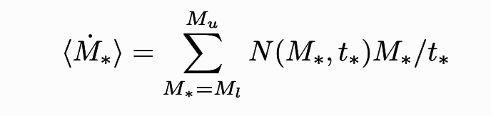
Color Magnitude Diagrams
Problems:
Young Stellar Populations: mass determination
Older Clusters: age determination

Slide 4
UV Continuum
Problem- Dust!
UV spectral slope (β)
IRX-β relation
Shape of dust extinction curve
Presumed intrinsic colours
Geometry of dust

Slide 5
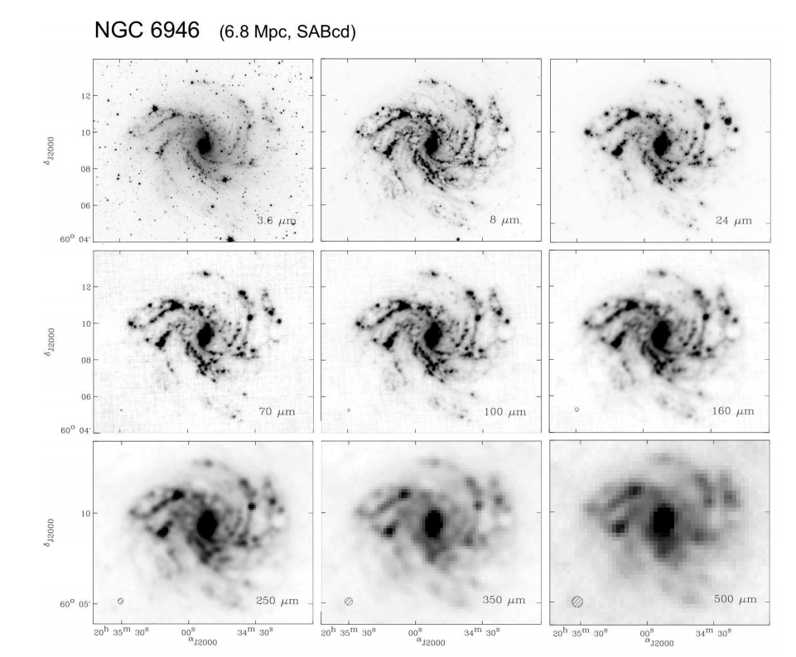
IR

Slide 6
IR Continuum
Starlight not absorbed by dust is missed- underestimated SFR
Dust Heating
Young stars + old stars mix affects IR emission
In high SFR galaxies two effects compensate!
Will definitely fail for low SFR, low metallicity or dust-free environments
Notes:
Spatial Resolution
Top- Sptizer IRAC (Stars, PAHs, Small Dust grains)
Middle- Herschel PACS, increasing contribution from diffuse emission with increase in wavelength
Bottom- Herschel SPIRE, cooler emission+ submillimeter excess

Slide 7
Emission Line Tracers
H𝜶
[O II]
Ly𝜶 -- high redshift galaxies
[Ne II] + [Ne III]
[C II]
Notes:
Nearly instantaneous SFR
Problems with Ha:
Dust attenuation
Balmer line decrement- approximate because it is sensitive to areas with smaller extinction
Attenuation of emission lines is higher than continuum
Account for underlying stellar absorption
Sensitivity to higher mass stars
Small number statistics in low SFR regions
Doesn’t help that they die quickly!
Escape fraction of Lya

Slide 8
Problems with H𝛼
Dust attenuation
Balmer line decrement is approximate-- sensitive to areas with smaller extinction
Emission lines attenuate more than continuum
Need to account for stellar absorption
Sensitivity to high mass stars
Small numbers in low SFR regions
Doesn’t help that they die quickly!

Slide 9
Radio Continuum
Ionizing gas => Free-free emission
Tight correlation between non-thermal emission and far-IR emission

Slide 10
X-ray Continuum
Massive X-ray binaries + Supernova
Strong correlation with both IR and non-thermal radio continuum

Slide 11
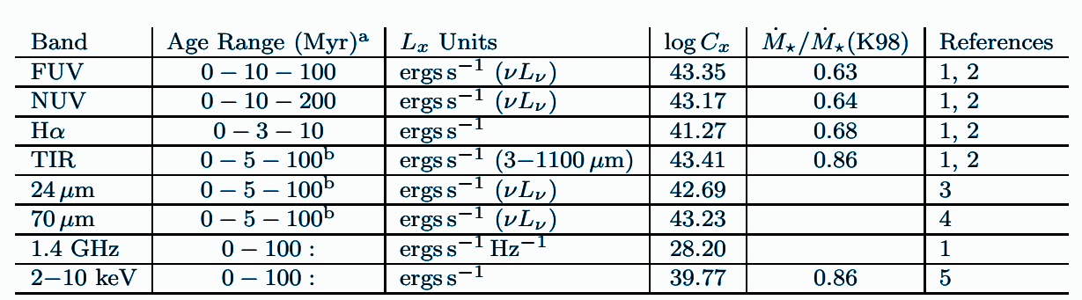
Updated Calibrations

Slide 12
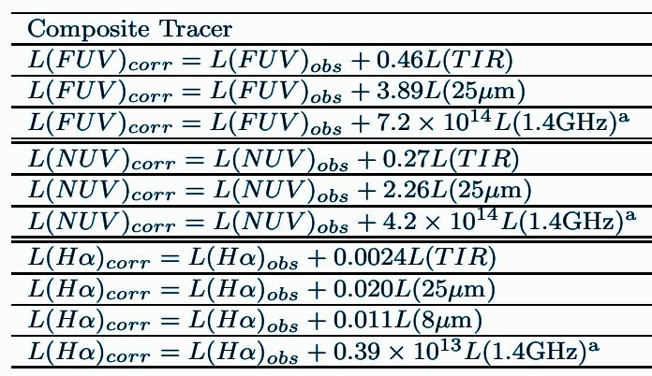
Multi-wavelength corrections

